Slide 1
CSCI 45 Computer Architecture
Professor Kerney Representing

Slide 2
Agenda
Binary Representations of Assembly
Powers of 2
Homework 1.5
Introduction to Computer Architecture
Caching
Set up the Raspberry Pis

Slide 3
Reminder
Your first group extra credit is due on Tuesday. Make sure you meet with your group and work for those 50 or 100 extra credit points.
Again, your goal is to create a web-based point tracker for each house’s scores.

Slide 4
Binary Representations
Quick review of counting in binary...
0 = 0
1 = 1
2 = 10
3 = 11
4 = 100
5 = 101
6 = 110
7 = 111
8 = 1000... etc.

Slide 5
Binary Representations
Have you heard of “32-bit systems” or “64-bit systems”? The term is an oversimplification, but what it usually means is how many bits the CPU reads at a time.
The first few bits of an instruction say which command to do, and then the remaining bits can specify registers or numbers or whatever. (Hence the limit on registers!)
Every CPU will publish a list of “opcodes” that correspond directly to an assembly command. So, for example, ADD might be opcode 0001, SUB might be opcode 0010, MUL opcode 0011, and so forth.
If we’re using four bits to pick our operation, the CPU can support 2⁴ (16) possible different operations.

Slide 6
Binary Representations
So we’ve reserved four bits for our choice of instruction on a 32 bit platform, that means each instruction will have 28 bits left over to do stuff like this:
ADD r0,r1,#8
MUL r7,r3,r11
AND r3,r14, #0xFF
If we have 16 registers, that will take up 4 bits to specify which one we want, and since we have three arguments to each operation, that’s another 12 bits.
If we want to allow immediate numbers in there (#8 or #255), then we’ve got 16 bits left over to hold numbers from 0 to 65535. Not too shabby!

Slide 7
Powers of 2 Cheat Sheet
If you have 1 bit, you can hold two possible numbers with that bit: 0 and 1.
If you have 2 bits, you can hold the numbers 0 through 3
3 bits: 0 through 7
4 bits: 0 through 15
5 bits: 0 through 31, etc.
What if you want to support negative numbers?
Add another bit to hold the sign.
(We’ll learn a better way later)

Slide 8
Homework 1.5 – ISA Compiler
Don’t turn Homework 1 in, we’re adding to it today.
First, answer these questions (on your paper homework)
How many different instructions does our terrible ISA have? How many bits will we need to represent it?
How many different registers does our terrible ISA have? How many bits will we need to represent it?
What range of immediate (constant, literal) numbers do you need to make your three programs work? How many bits do you need to represent that range of numbers?
What about negatives? Will that take up a bit?

Slide 9
Homework 1.5
So, given the bit budgets you’ve just established, look at your programs and figure out how many bits your longest instruction will take up. Call it X: ___________
So you will need only an X-bit CPU to run your program!
Now come up with a mapping from your instructions to binary, write it as a table. For example:
(or vice versa)
Do the same (make a table) for all 4 registers, mapping them to binary.
Do the same for your immediate values.
ADD | 0
JGZ | 1

Slide 10
Homework 1.5
Now that you know how long each instruction should be (X bits), go ahead and convert each of your lines of code into 1s and 0s.
You should end up with something like this for Puzzle 1:
000100 (which means ADD r0,r2)
001001 (which means ADD r1,-1)
100000 (JGZ)
etc.
For funsies, write them down as one long contiguous block of 1s and 0s: 000100001001100000 (the above)

Slide 11
Homework 1.5
Due Date: Start of next class.
What you will turn in:
Homework 1 (a page or so of hand-written assembly)
Your answers to the questions posed to you on the earlier slides in this section (for example your bit budgets)
Your tables mapping instructions and registers, etc. to binary.
Your three programs converted from assembly to binary.
Ever wonder what the result of doing a “g++ main.cc” is? Guess what - those 1s and 0s is the result. (Basically)

Slide 12
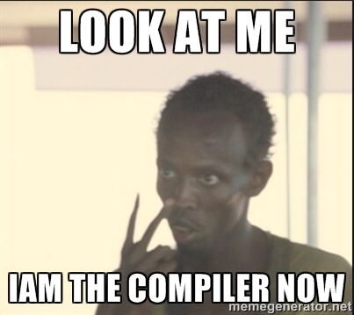

Slide 13
ARM’s bit budget
They actually have a dozen or so different versions, but this is the most common way they have of breaking an instruction down into bits:
OPCODE is the command
Rn is the destination register (4 bits)
Rs is the source register (4 bits)
Operand-2 is a literal or a third register
Don’t worry about the rest

Slide 14
Middle School Computer Architecture
If you had a good teacher you would know...
You have a “hard drive” that holds programs and data.
Example: Microsoft Excel, and a spreadsheet.
High performance “RAM” holds the programs and data while it is running. Use RAM because hard drives are slow.
A “CPU” runs programs using the stuff in RAM.
You use a “mouse” and “keyboard” for input
A “monitor” displays output
...or worse, you could have had a teacher that thought the case was “the CPU”...

Slide 15
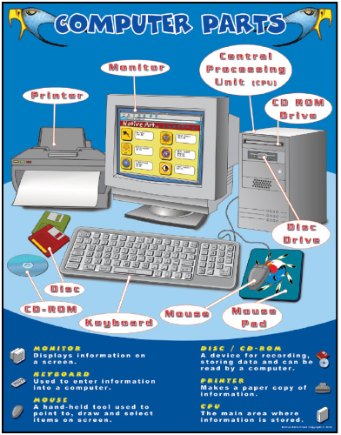
Notes:
Terrible Middle School “Computers” Poster

Slide 16
...but that’s basically wrong
“Memory is the new disk” – RAM is actually very slow.
You want to do everything possible in registers, and touch memory as little as possible.
To put things in perspective, you can perform 200 additions in a row in the same amount of time it takes to load a single integer into a register from RAM.
If programs were actually “held in RAM”, and we had to load each instruction one at a time from memory, we’d only be able to use 1/200th of a CPU.
Also, our conception of a CPU is inaccurate.

Slide 17
Load/Store Architectures
Early architectures allowed you to do things directly in memory, for example the Motorola 68K family allowed you to add the value in one memory address to another.
This is called a “Register + Memory Architecture”
As you can imagine, this could cause a performance hit.
So many modern architectures (like ARM) disallow working directly with values in RAM.
The only thing you can do with RAM is load values into a register from RAM, and then later on store them back.
Hence the term: “Load/Store Architecture”
All the work is done in registers instead, for speed reasons

Slide 18
Caching
In order to avoid these horrible costs associated with loading and storing to RAM, CPU designers put things called “caches” between the CPU and RAM.
Caches work by retaining the Most Recently Used addresses from memory (generally speaking).
Overall, 80% or 90% of your load/stores are going to be done to places you’ve recently touched, or nearby.
Fast caches (less delay) are very very expensive, so most modern CPUs implement multiple tiers of caching.
Level 1 Cache is typically small, but very fast
Level 2 Cache is typically bigish, and medium speed
Level 3 Cache is large and slow (but still better than RAM)

Slide 19
Cache Sizes
Stats for an Intel Skylake i7-6700K. (Data Sheet)
L1 Cache is 256KB
128KB for Instructions (i.e. your program)
128KB for Data
L2 Cache is 1MB
L3 Cache is 8MB, shared by all four cores
Has an optional L4 Cache, too

Slide 20
Cache Sizes
Stats for an ARM Cortex-A9 (not our Pis)
L1 Cache is 64KB
32KB for Instructions (i.e. your program)
32KB for Data
Optional L2 Cache is 128KB-8MB
An integrated GPU often claims the L2 cache

Slide 21
Cache Speed
Here’s a rough estimate of how long it takes to load an int from a cache in terms of cycles, or how many simple instructions like adds you can do in the meantime:
1 cycle for a register
4 cycles for L1 cache
10 cycles for L2 cache
75 cycles for L3 cache
200 cycles for RAM
1200 cycles for SSD*
20,000 – 1,000,000 cycles for HDD*

Slide 22
Caching
There’s a lot of ways caches can be put together (you’ll learn more about the varieties later).
The simplest way is like something called a hash table.
The spot something hashes to is the memory address modulus the hash table size.
Suppose your L1 cache has slots in it for 10 integers.
If you try to access memory location 4332, the cache will hash that to slot 2 (4332 % 10). If that value is in there, it will return the value.
Otherwise, it’ll load the value from RAM, and when the number comes in, it will store in in slot 2 and pass it on to the CPU.

Slide 23
Fun Cache Exercise

Slide 24
Raspberry Pi Time

